Slide 1
Customer Distribution and Deactivation Analyses
SAS Project By
Xue Liu (Alexia)

Slide 2
AGENDA
Objective
Background
Key findings
Recommendations
Appendix:
Data sources
Data methodology
Data model assumptions
Notes:
Objective

Slide 3
OBJECTIVE
Gain insightful understanding about the customers behavior and the reason why customer’s attritions.
Uncover the customer distribution by status, tenure, credit, residential region, channels and all other related factors.
Provide early recommendations to our marketing and operations teams
Notes:
Objective

Slide 4
BACKGROUND
Given today's marketplace demands, it is more important than ever for businesses to reduce customer attrition. To do that, the wireless company would like to uses behavioral analysis to categorize customers and design strategies that will to minimize customer attrition and sustain and maximize the activities of the most valuable customers.
Notes:
Objective

Slide 5
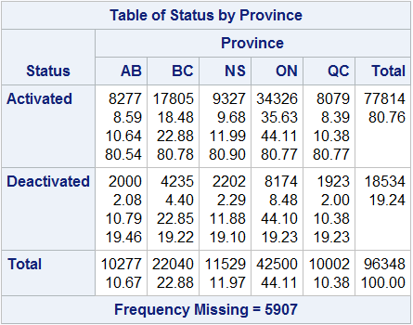
Key Findings #1
For each province, the proportion of activated accounts to the overall accounts is 81%
Consistency in proportions could reflect business trends or policies.
If there are similar market dynamics, customer demographics, or industry trends across provinces, business decisions might lead to a uniform ratio of activated and deactivated accounts.

Slide 6
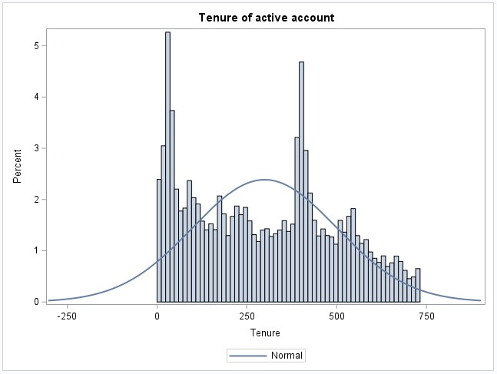
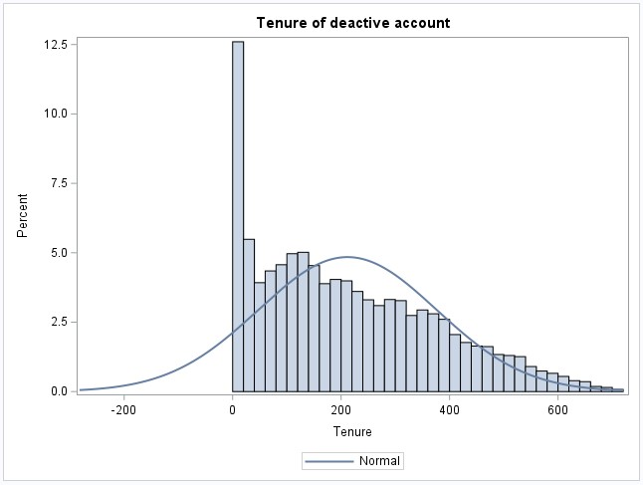
Key Findings #2
Use Proc Sgplot to visualize the Tenure distribution.
These two charts are both descending trends, which might be caused by the following reasons:
1. Account Lifespan:
The descending trend in the chart might suggest that most accounts have relatively short durations of usage.
2. Customer Loyalty:
Short account tenures could imply lower customer loyalty.
3. Market Dynamics:
In certain cases, short-term account deactivations could reflect the intensity of market competition.

Slide 7
Key Findings #3
The age under 5 has 691 observations showing that there are a lot of data younger than 5 years old.
This could be due to two reasons:
1. It is mandatory to provide a valid ID when opening an account and many parents open accounts for their children. When the baby is under one year old, the system will input age=0.
Maybe new users have a better deal, Parents open an account in the name of the child, and the parents use it themselves.
2. It is not mandatory to provide a valid ID when opening an account. Many people fill in their age at will or even don’t fill in it.

Slide 8
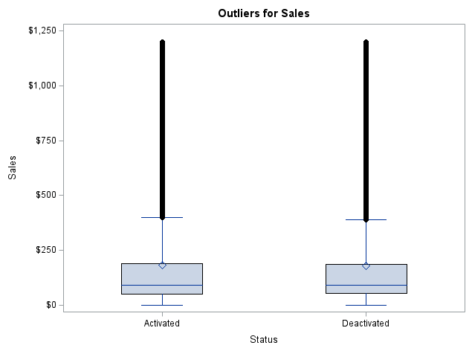
Key Findings #4
The outliers for sales represent transactions with unusually high values, and might have the following practical meanings:
1. Outliers in sales amounts could be indicative of data entry errors, measurement inaccuracies.
2. Outliers on the high end could represent large orders, significant contracts, or high-value customers. These transactions might have strategic importance or unique requirements, which might influence business decisions or sales strategies.

Slide 9
Key Findings #5
Most sales amounts are relatively small, but there are also some more significant sales amounts, potentially representing a few significant transactions or the existence of outliers.
A positive skewness value suggests a right-skewed distribution of sales amounts. This could indicate that most transactions have smaller amounts, but a few transactions with higher amounts impact the overall distribution.
The Kurtosis value is 5.28, which is significantly greater than 3. A high kurtosis value could indicate that the distribution of sales amounts has a relatively sharp and pronounced peak. It might imply the existence of outliers or large orders within the sales amounts, or that certain transaction amounts are relatively concentrated.

Slide 10
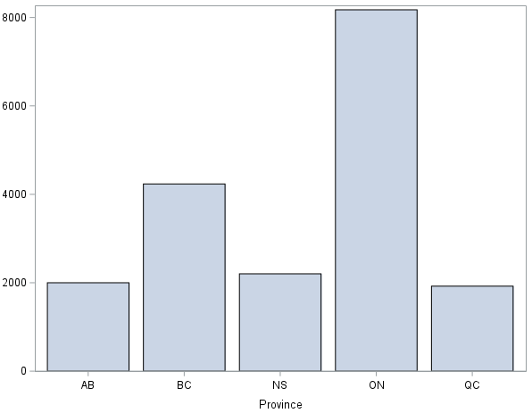
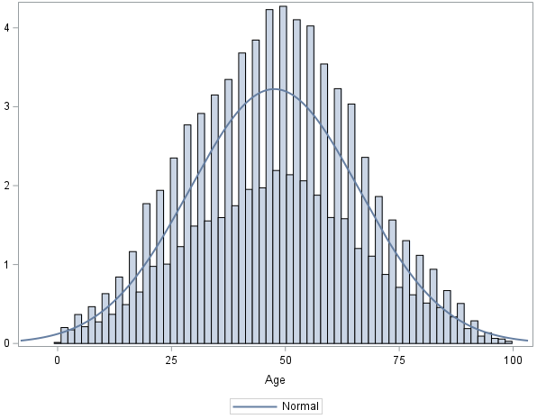
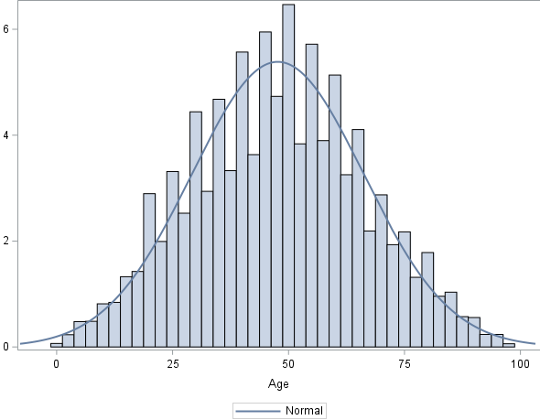
Key Findings #6
After use Proc Sgplot to visualize province and age distributions.
Found that active accounts and deactivated accounts are mainly concentrated in the ON province. Among the provinces, the QC province with the smallest proportion of active accounts and deactivated accounts.
And the overall age is mainly concentrated in the middle-aged crowd.

Slide 11
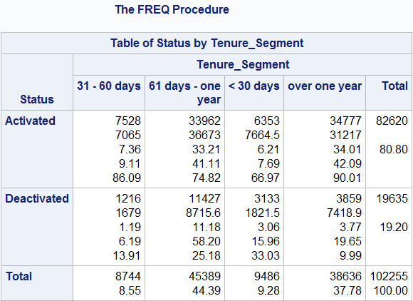
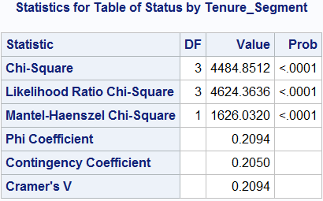
Key Findings #7
Is there any association between the account status and the tenure segments？
Use Proc Freq to test the association between the account status and the tenure segments.
H0: There is no significant association between the account status and Tenure segments.
All the Chi-Square Probability are <.0001, which indicates that we can reject this null hypothesis, and conclude that there is an ASSOCIATION between the account status and Tenure segments, rather than just random differences.

Slide 12
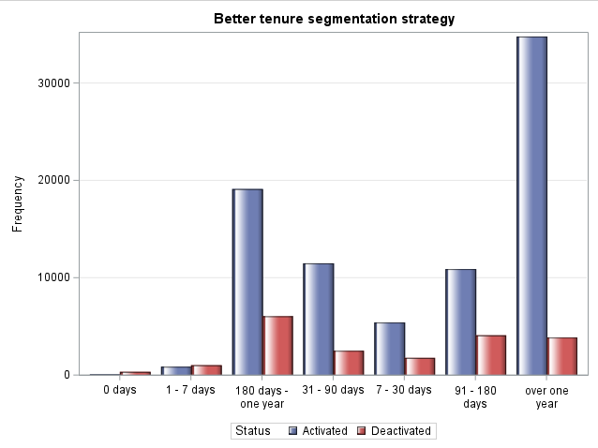
Key Findings #7
A new tenure segmentation is:
0 days, 1-7 days, 7-30 days, 31-90 days, 91-180 days, 180 days – one year, over one year
Use Proc Freq to test the association between the account status and the new better tenure segments and use Proc Sgplot to visualize the distribution.

Slide 13
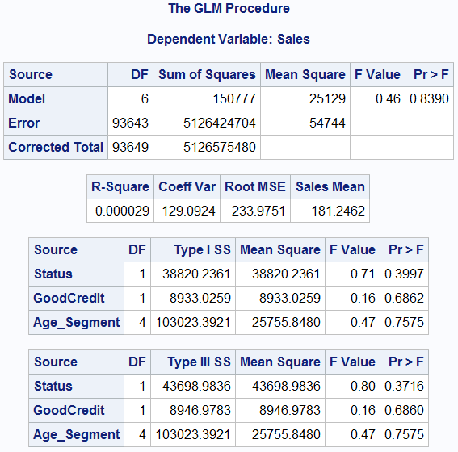
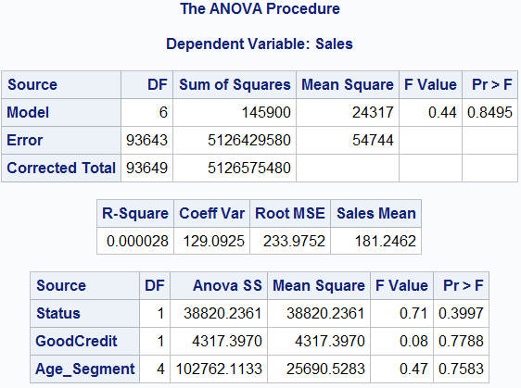
Key Findings #8
Use Proc GLM to check the significant difference and use Proc ANOVA to check the significant association.
After testing the Sales and Status, Sales and GoodCredit, Sales and Age segments
All the p-values are higher than 0.05, which indicates that we can not reject the Null Hypotheses, we haven't found strong evidence to conclude that
There are significant differences in sales amount among different account statuses, GoodCredit, and age segments.
All the p-values are higher than 0.05, which indicates that we can not reject the Null Hypotheses and conclude that
There is no association between the Sales and account status, GoodCredit, and age segments.

Slide 14
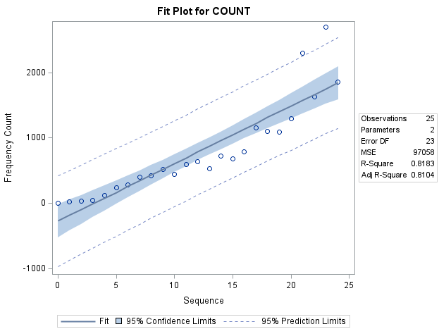
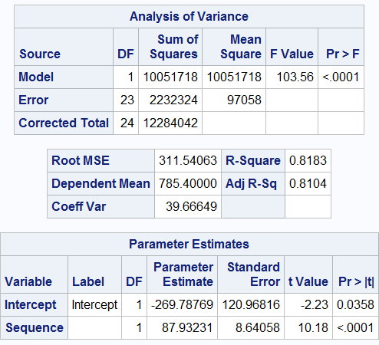
Key Findings #9
Forecast the deactivation trends for the next 6 months.
First, input the time data for the next 6 months and add sequence numbers to the existing months.
Then use Proc Corr and Proc Reg to find the Parameter Estimate: B0=-269.78769, B1=87.93231, use these two numbers to predict the deactivation trends for the next 6 months.

Slide 15
RECOMMENDATIONS
The overall age is mainly concentrated in the middle-aged crowd. Based on stabilizing the middle-aged group, we can develop new users in the 20-40-year-old group
There have 69.44% of accounts are good credit, and 30.56% of accounts are bad credit. The proportion of bad credit accounts is too high. In the future, when opening an account, the customer’s credit rate should be properly checked.
The proportion of RatePlan#1 to the overall data is twice the sum of RatePlan#2 and RatePlan#3. This means that RatePlan#1 is more popular, and we can consider that launch more plans like RatePlan#1 in the future.
There 54.87% of accounts are A1, more than all other DealerTypes combined. It may be because the deals provided by this dealer are cost-effective, or it may be that the dealer provides a variety of deals and covers a wider range of areas.
Notes:
Objective

Slide 16
Thank You

